Slide 1
AfriWatSan: Sustaining Low-cost, Urban
Water Supply and Sanitation Systems in Africa www.afriwatsan.org
AfriWatSan Team at the 2018 Water and Health conference
Water and Health conference, Water Institute at the UNC, at Chapel Hill (United States), October 29–November 1, 2018.
Africa Capacity Building Initiative
supported by

Slide 2
THE TEAM AT THE WATER AND HEALTH CONFERENCE
Two PhD students of Afriwatsan project (Jacintha Nayebare from Uganda and Mor Talla DIAW from Senegal) and WASH Policy Team Leader at DFID (Guy Howards) at the conference.

Slide 3
THE TEAM AT THE WATER AND HEALTH CONFERENCE
Two PhD students of the Afriwatsan project (Jacintha Nayebare from Uganda and Mor Talla DIAW from Senegal) and WASH Policy Team Leader at DFID (Guy Howards) at the conference.

Slide 4
The Team’s Activities
Poster Presentations
Nayebare Jacinta : Managing conjunctive use of the subsurface for on-site water supply and sanitation: an evaluation of health risks in a small town in Uganda
Oral Presentations
Mor Talla : The relationship between on-site sanitation density and shallow groundwater quality: evidence from remote sensing and in situ observations in Dakar, Senegal

Slide 5
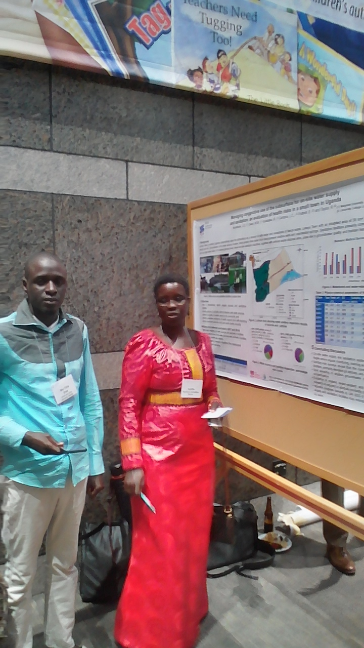
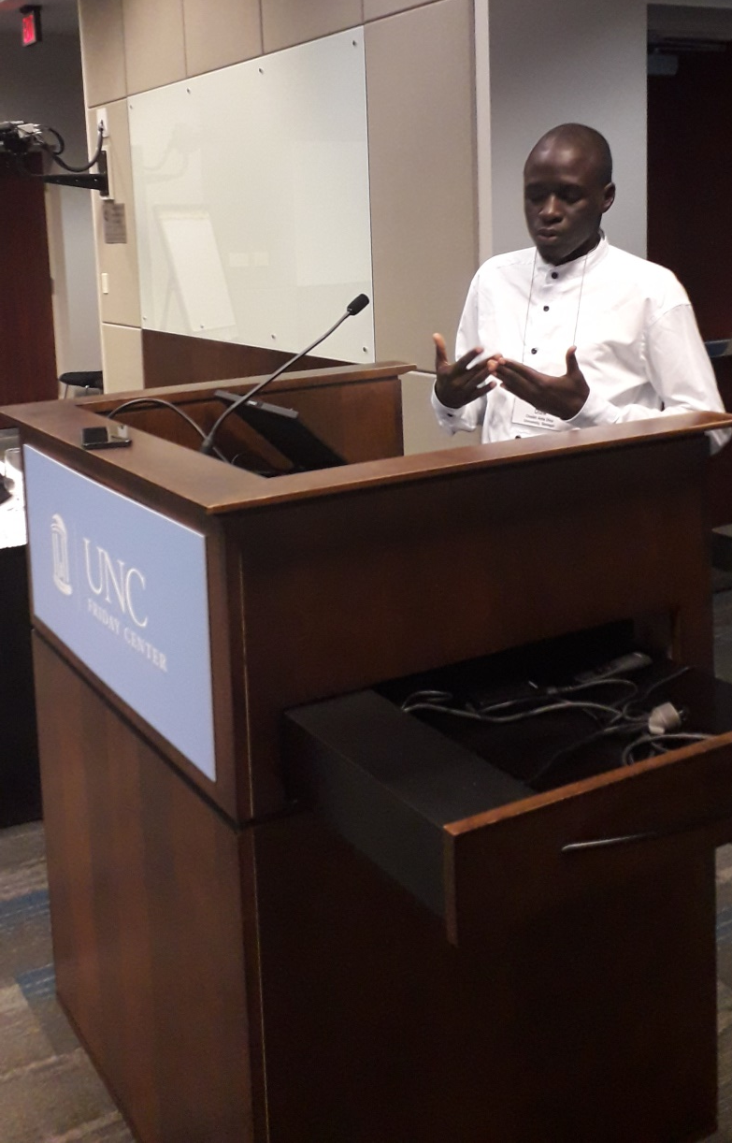
Jacintha at the poster display
Mor Talla at the podium
1

Slide 6
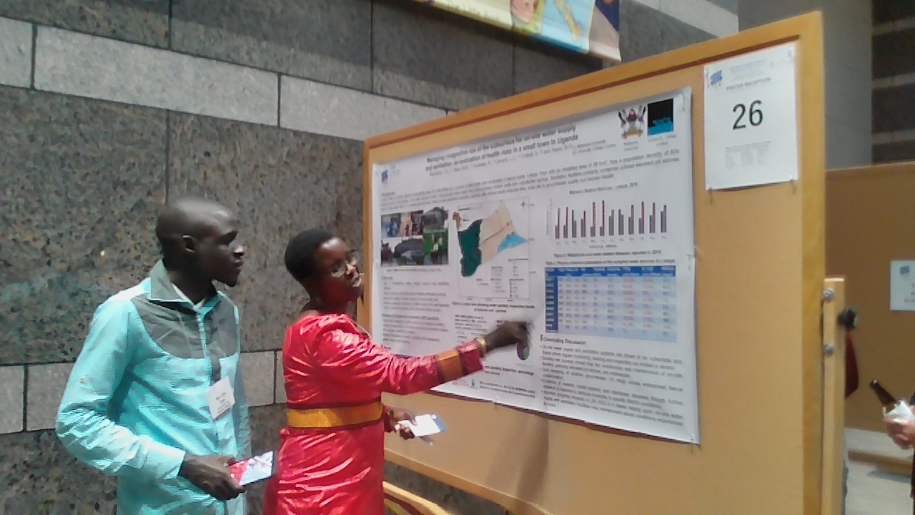
Jacintha and Mor Talla at the poster display

Slide 7
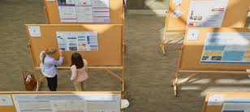
Jacintha and Mor Talla at the poster display
2

